Slide 1
Submitted by: Swathi Vimala
Course: Data analyst / SQL
Year: 2026

Slide 2
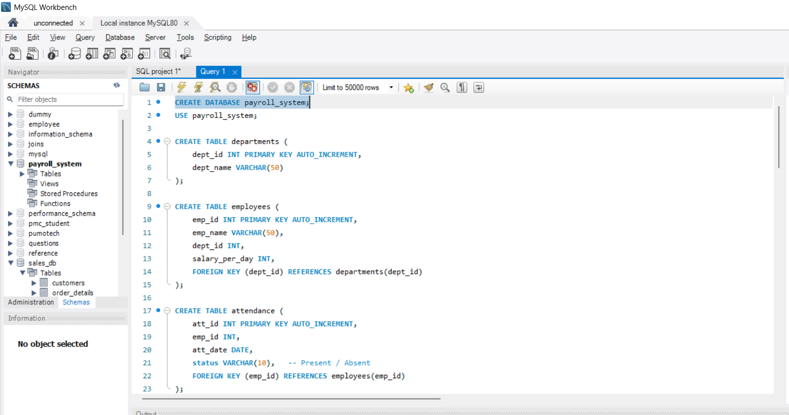
CREATE DATA BASE
How do you create a database for the Payroll System

Slide 3
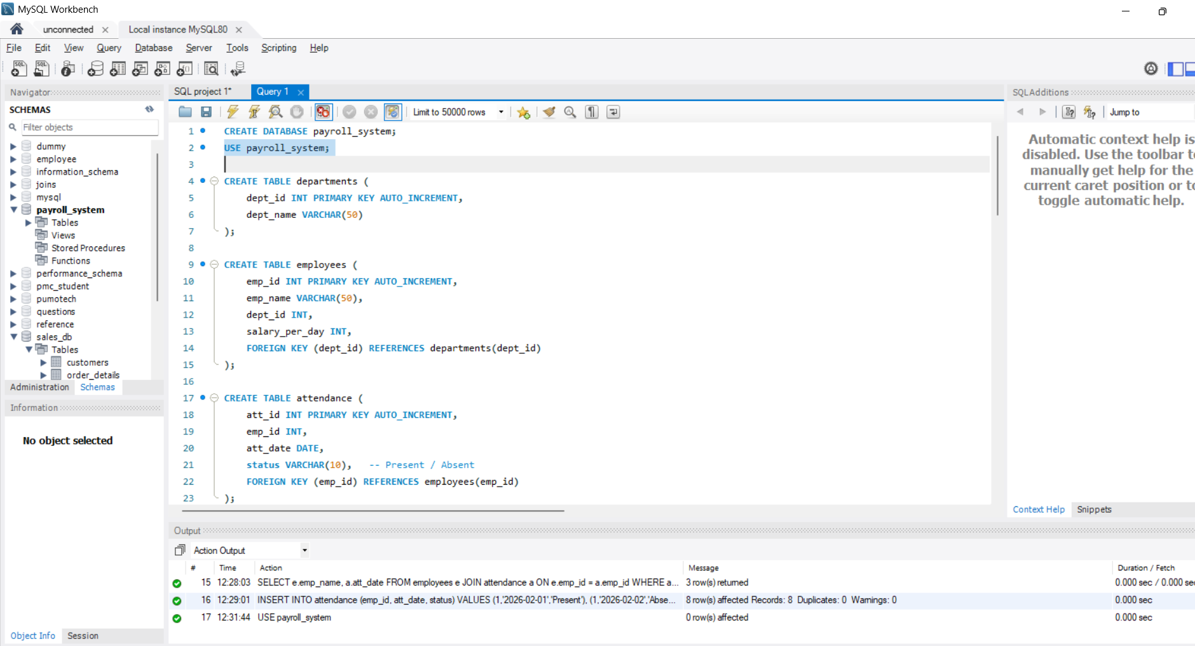
USE PAYROLL_SYSTEM
How do you select the Payroll database for usage

Slide 4
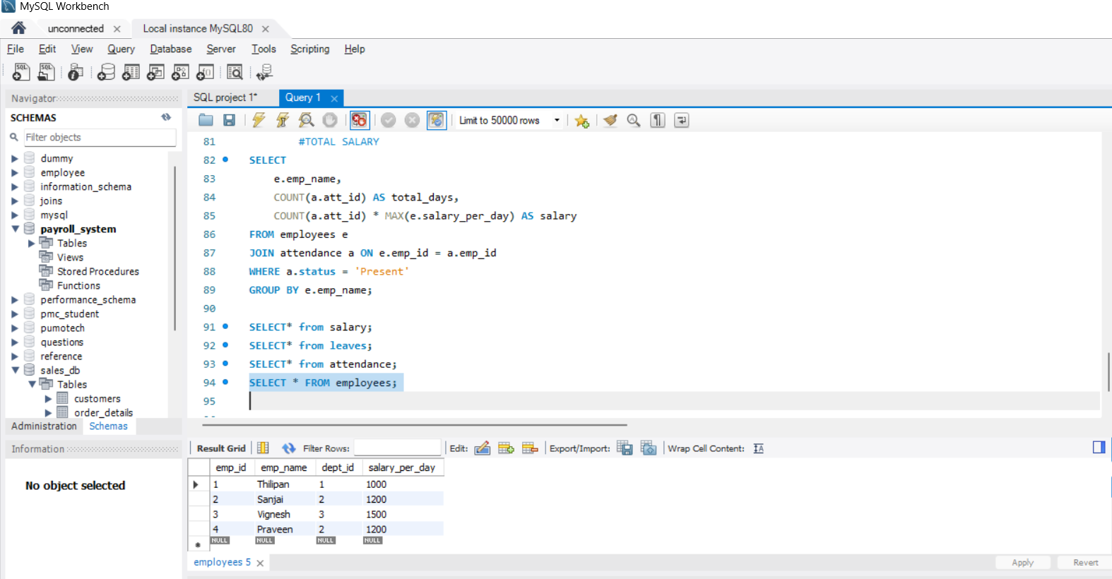
Employees
How do you display all employee records

Slide 5
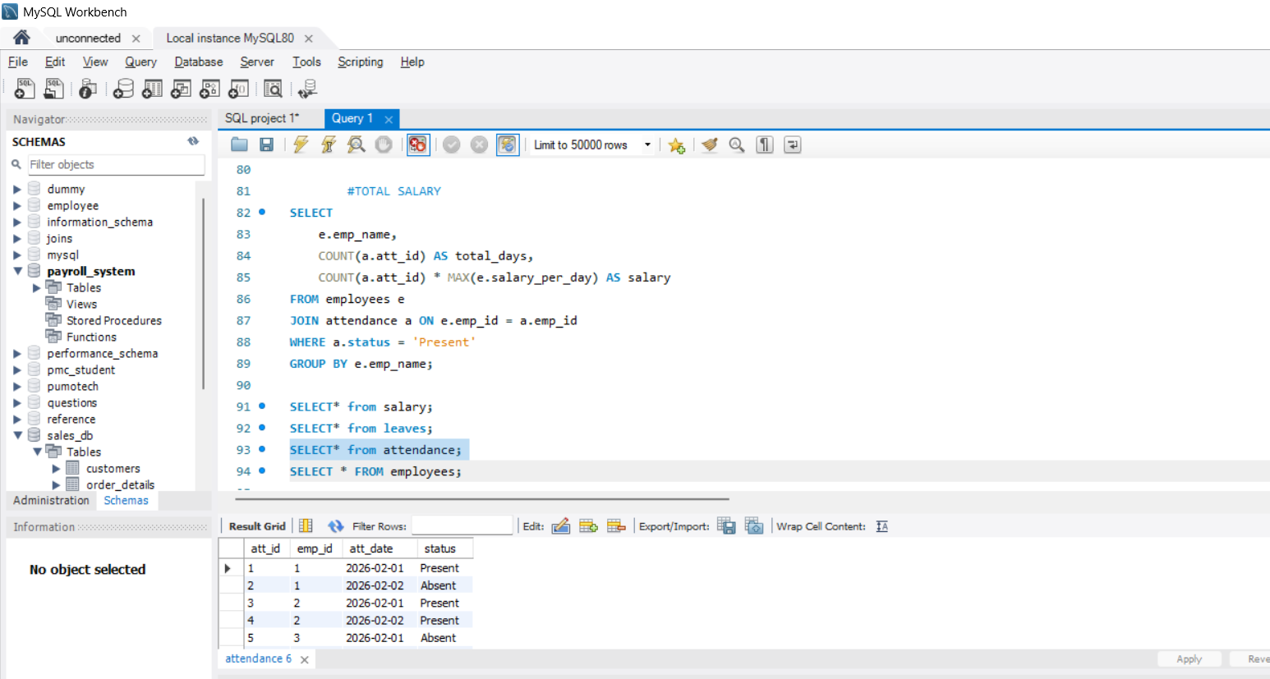
attendance
How do you view employee attendance details

Slide 6
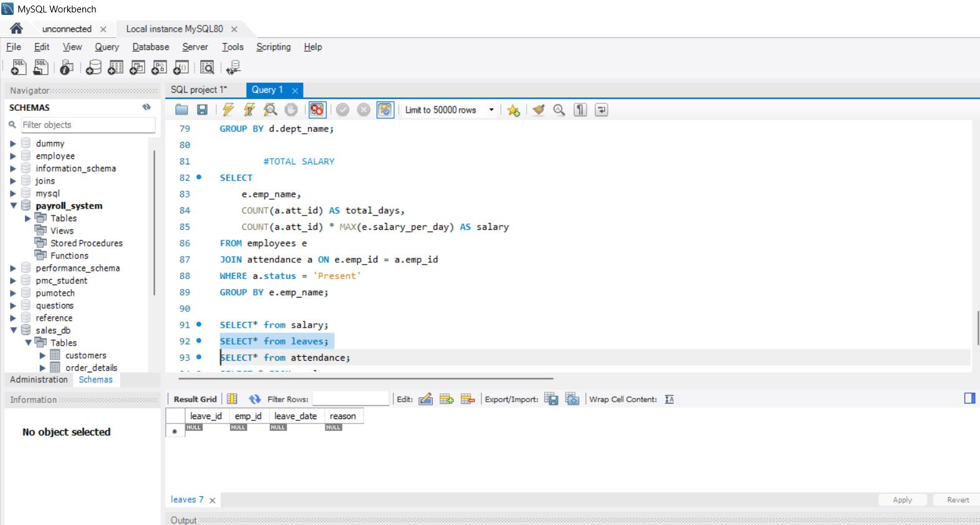
leaves
How do you view employee leave records

Slide 7
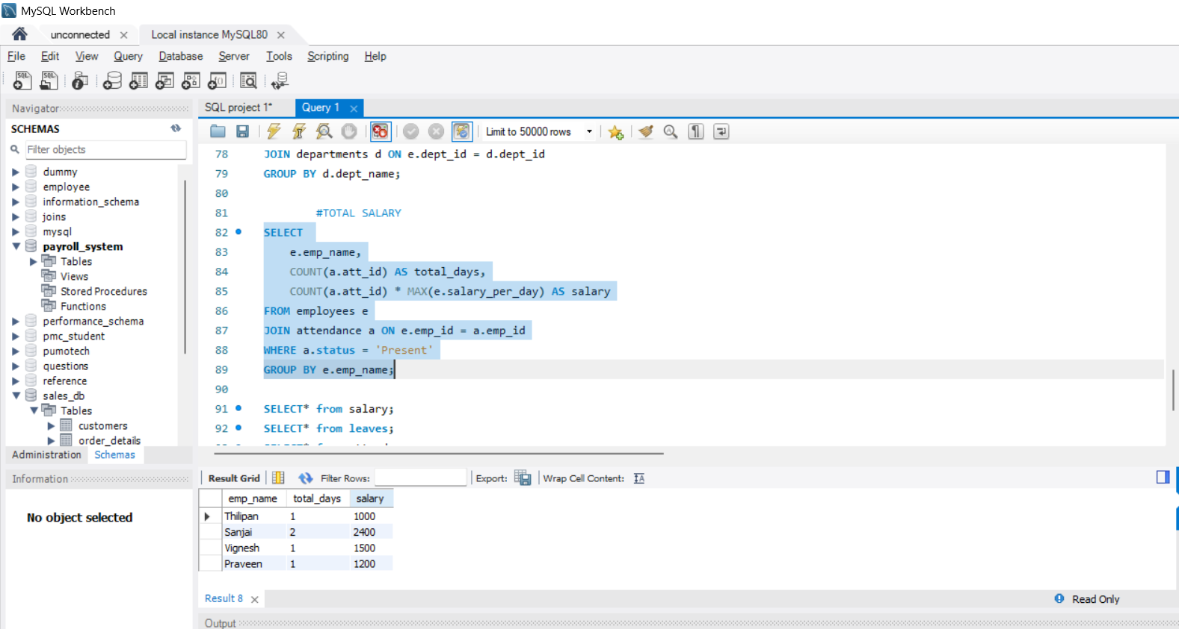
TOTAL SALARY
How do you calculate the total salary of each employee based on attendance

Slide 8
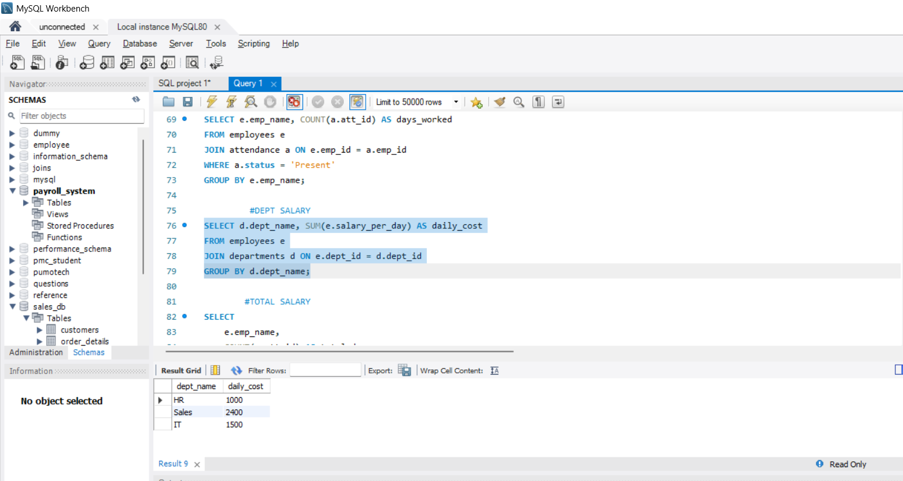
DEPT SALARY
How do you calculate daily salary cost for each department?

Slide 9
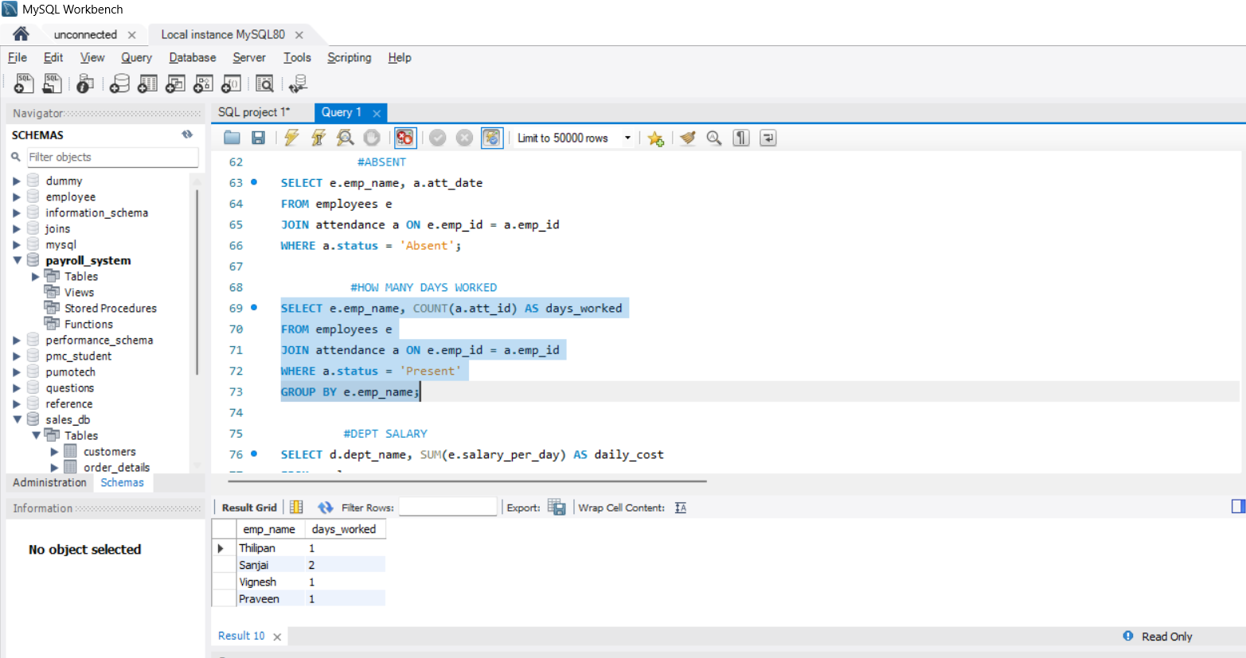
HOW MANY DAYS WORKED
How do you find how many days each employee has worked

Slide 10
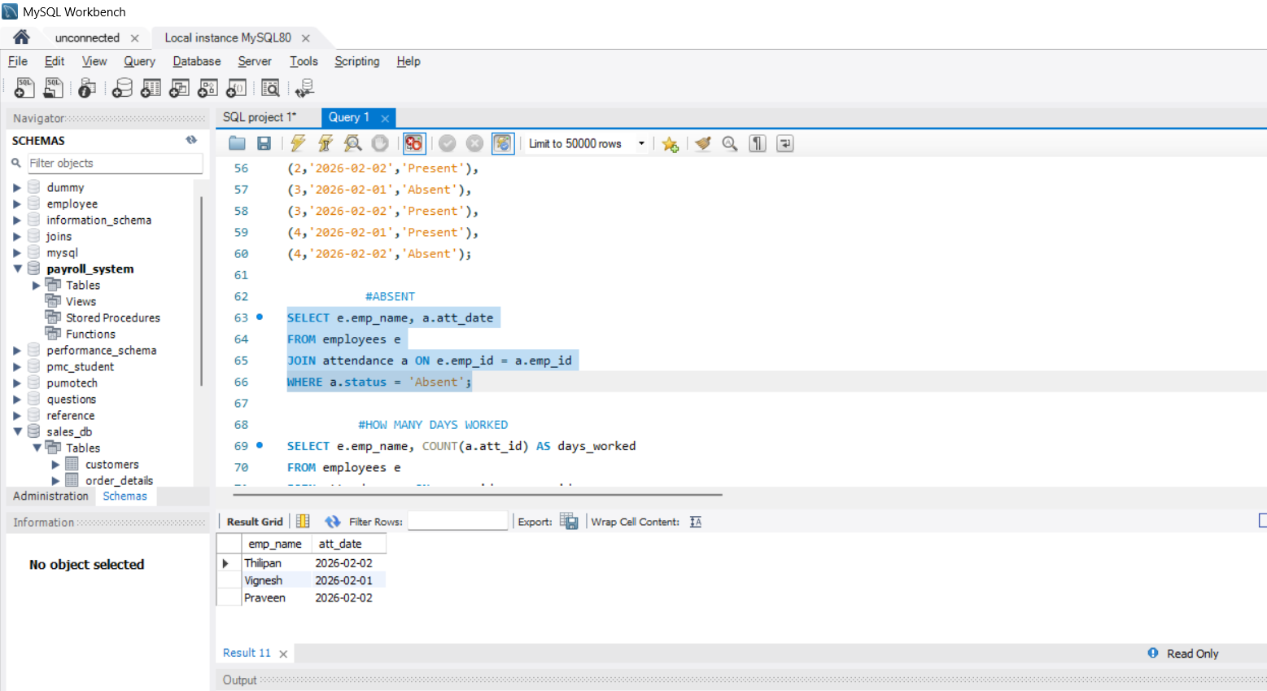
ABSENT
How do you list employees who were absent along with the date

